Slide 1



Breakdown of the data professionals survey
View in Power BI
Last data refresh:
5/14/2023 11:14:14 AM UTC
Downloaded at:
5/14/2023 11:23:34 AM UTC

Slide 2
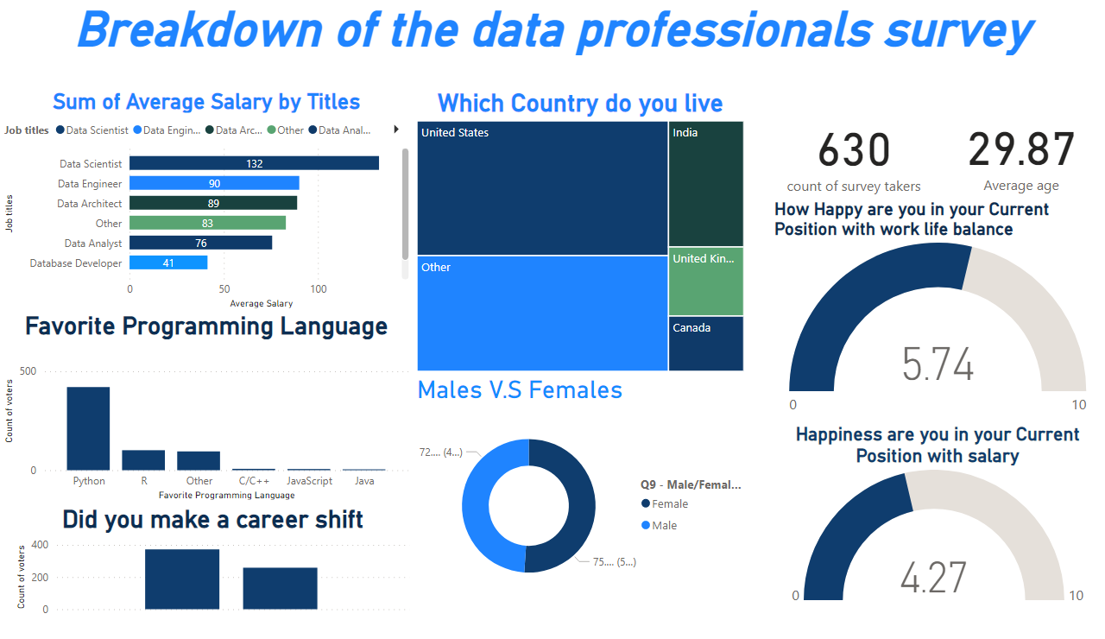
Page 1
Notes:
Breakdown of the data professionals survey
No alt text provided
card
No alt text provided
card
No alt text provided
Sum of Average Salary by Titles
No alt text provided
Favorite Programming Language
No alt text provided
Did you make a career shift
No alt text provided
Which Country do you live
No alt text provided
How Happy are you in your Current Position with work life balance
No alt text provided
Happiness are you in your Current Position with salary
No alt text provided
Males V.S Females
No alt text provided

